Slide 1


3D Graphics
Workshop 16 – Coursera week 19

Slide 2
Particle System
Solid object
Use polygons with texture
Non solid object
E.g. Liquid, water, gases, smoke, fire, snow
Use Particle System

Slide 3
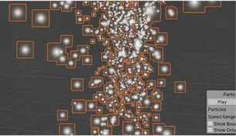
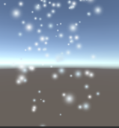
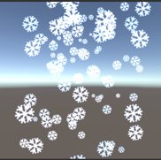
Particle System
Particle systems are modelled as a bunch of individual particles.
In Unity, each particle has an orange box around it.
For example to model snow. represent each snow as a particle,
There are cases where it is much better to represent the particles in graphics (e.g. snowflake)

Slide 4
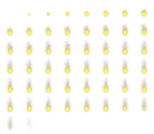
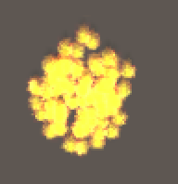
Particle System
To model fire, we can represent each particle as an animated sprite.
Each sprite is like an animated gif.

Slide 5
Particle System
Particle System loop
Create Particles
Assign parameters values to new Particle
Size, Lifetime etc.
Move and Transform particle
Location, Size, Colour etc.
Draw on Screen
Delete old particle (when lifetime is up)

Slide 6
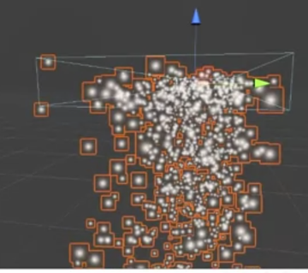
Particle System
Emitter
Object that emit particles every frame.
Can be
Box
Sphere
Cone etc.
Can be moved around in scene

Slide 7
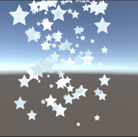
Lab
Work on Workshop 16
In this activity, we are going to implement the following effect using Unity Particle System.
Snow
Snowflake/Star
Fireball

